Slide 1

Generative Aversarial Networks
11785 Deep Learning
Spring 2022

Slide 2
Topics for the week
Transformers
GNNs
VAEs
GANs
Connecting the dots

Slide 3
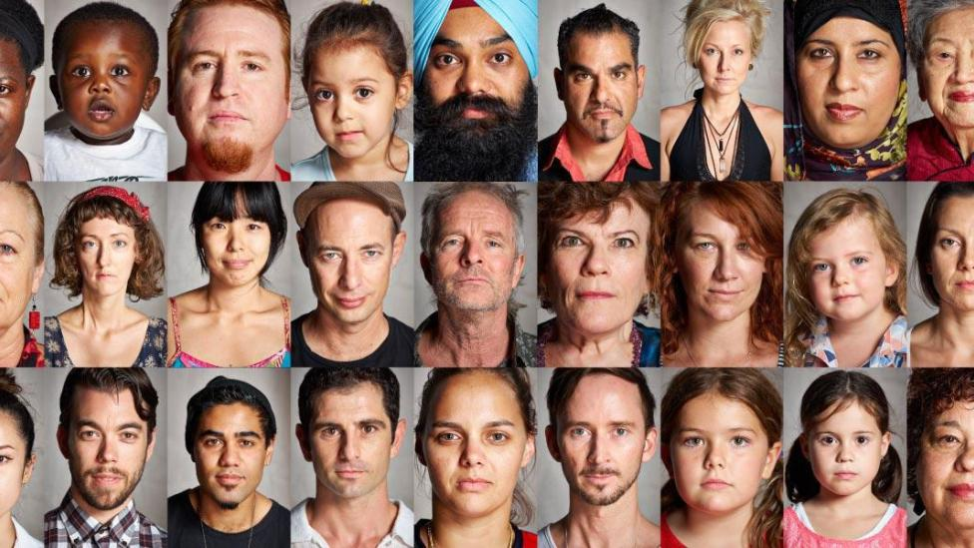
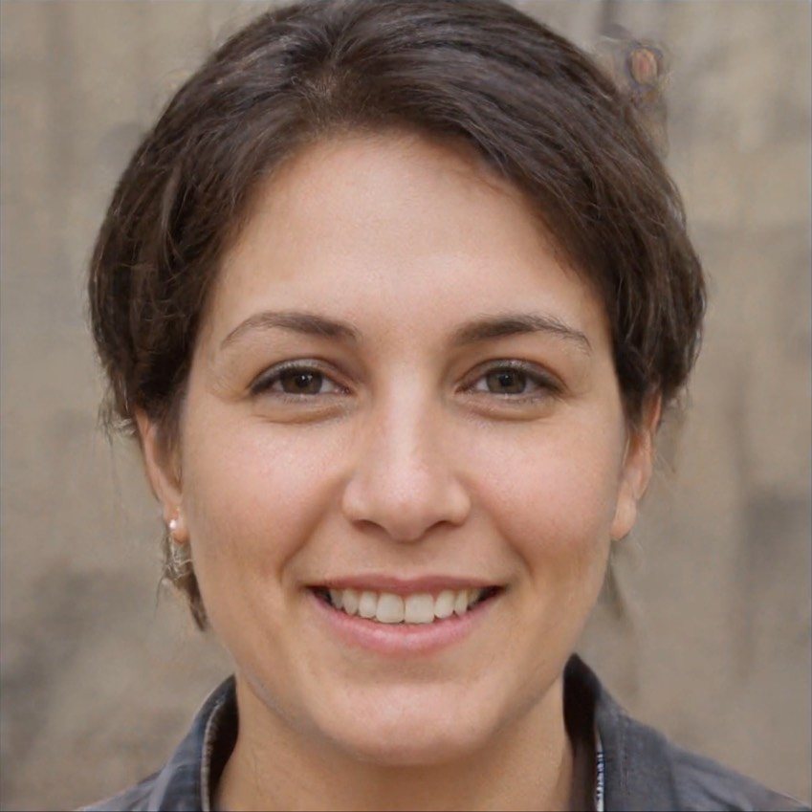
The problem
From a large collection of images of faces, can a network learn to generate new portrait
Generate samples from the distribution of “face” images
How do we even characterize this distribution?

Slide 4
What are GANs
Generative Adversarial Networks

Slide 5
What are GANs
Generative Adversarial Networks
Generative Models which generate data similar to the training data .
E.g. Variational Autoencoders (VAE)

Slide 6
What are GANs
Generative Adversarial Networks
Generative Models which generate data similar to the training data .
E.g. Variational Autoencoders (VAE)
Adversarial Training
GANS are made up of two competing networks (adversaries)
that are trying beat each other.

Slide 7
What are GANs
Generative Adversarial Networks
Neural Networks
Generative Models which generate data similar to the training data .
E.g. Variational Autoencoders (VAE)
Adversarial Training
GANS are made up of two competing networks (adversaries)
that are trying beat each other.

Slide 8
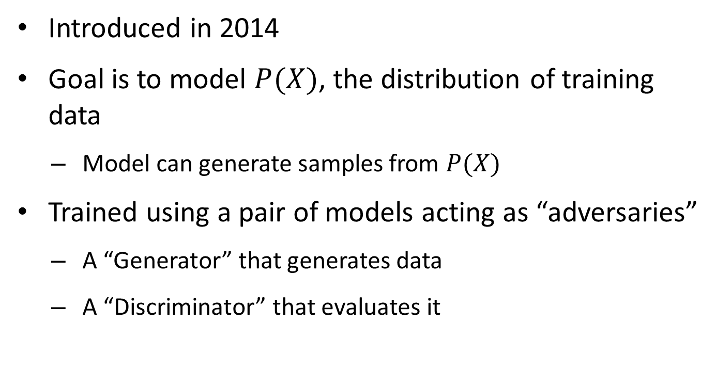
Generative Adversarial Networks
Introduced in 2014
Goal is to model $P(X)$, the distribution of training data
Model can generate samples from $P(X)$
Trained using a pair of models acting as “adversaries”
A “Generator” that generates data
A “Discriminator” that evaluates it

Slide 9

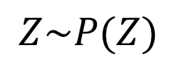
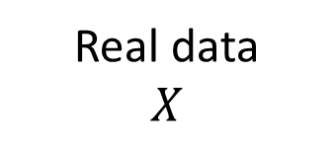
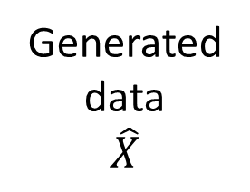
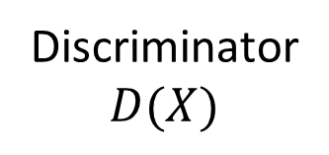
What are GANs?
Generated data $$\hat{X}$$
Generator $$G(Z)$$
$$Z\sim P(Z)$$
Discriminator $$D(X)$$
Real/Fake?
Real data $$X$$

Slide 10
What are GANs?
Generated data $$\hat{X}$$
Generator $$G(Z)$$
$$Z\sim P(Z)$$
Discriminator $$D(X)$$
Real/Fake?
Real data $$X$$

Slide 11
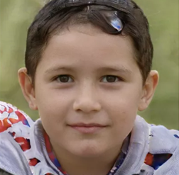
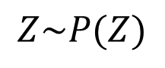
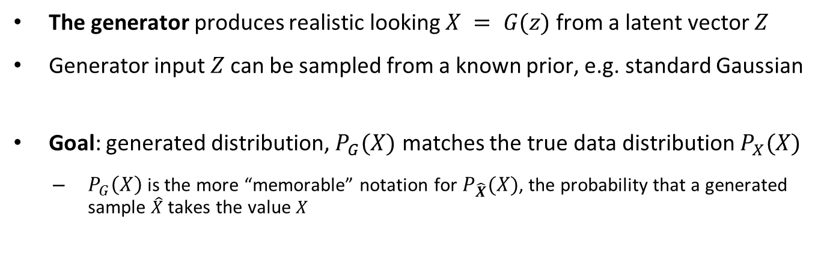
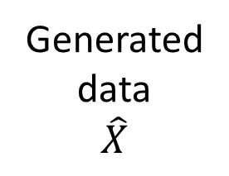

The Generator
Generated data $$\hat{X}$$
Generator $$G(Z)$$
$$Z\sim P(Z)$$
The generator produces realistic looking $X = G(z)$ from a latent vector $Z$
Generator input $Z$ can be sampled from a known prior, e.g. standard Gaussian
Goal: generated distribution, $P_{G}(X)$ matches the true data distribution $P_{X}(X)$
$P_{G}\left(X\right)$ is the more “memorable” notation for $P_{\hat{X}}(X)$, the probability that a generated sample $\hat{X}$ takes the value $X$

Slide 12

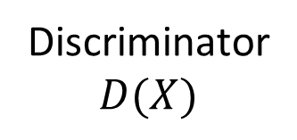
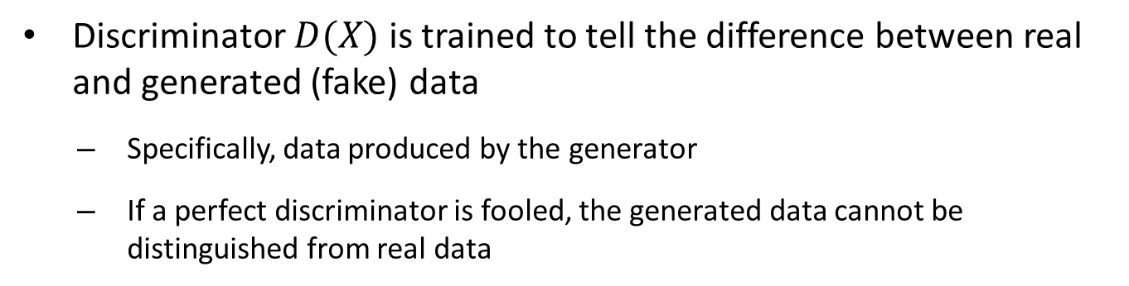
The Discriminator
Discriminator $$D(X)$$
Real/Fake?
Discriminator $D(X)$ is trained to tell the difference between real and generated (fake) data
Specifically, data produced by the generator
If a perfect discriminator is fooled, the generated data cannot be distinguished from real data

Slide 13
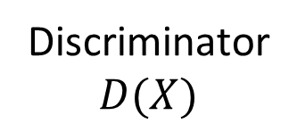
Training the discriminator
Discriminator $$D(X)$$
Real/Fake?
Training the discriminator:
The discriminator is provided training examples of real and synthetic faces
The discriminator is trained to minimize its classification loss
Minimize error between actual and predicted labels

Slide 14

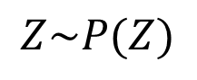
Training the generator
Generator $$G(Z)$$
Discriminator $$D(X)$$
Real/Fake?
$$Z\sim P(Z)$$
Training the generator:
The discriminator’s loss is backpropagated to the generator
The generator is trained to maximize the discriminator loss
It is trained to “fool” the discriminator

Slide 15
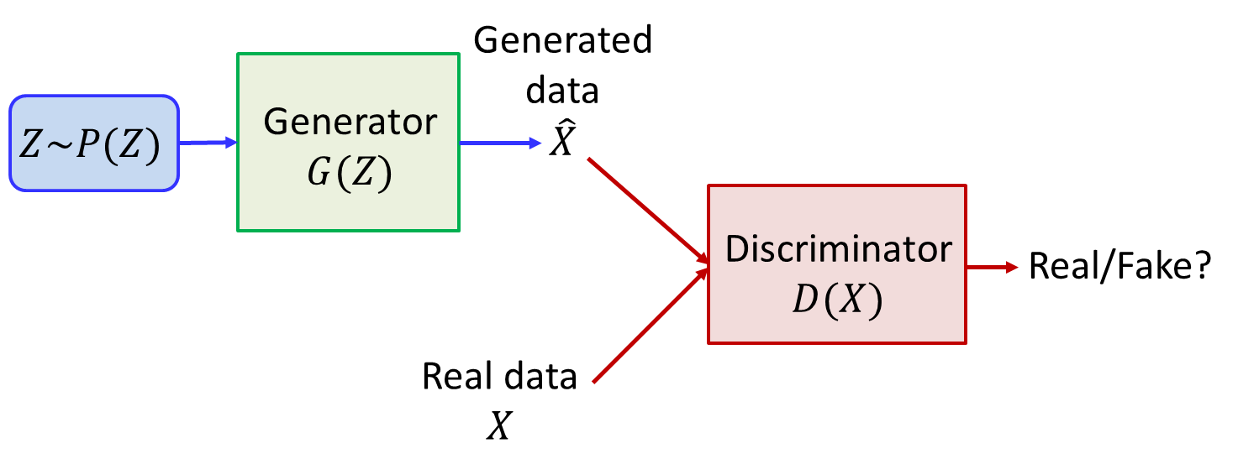
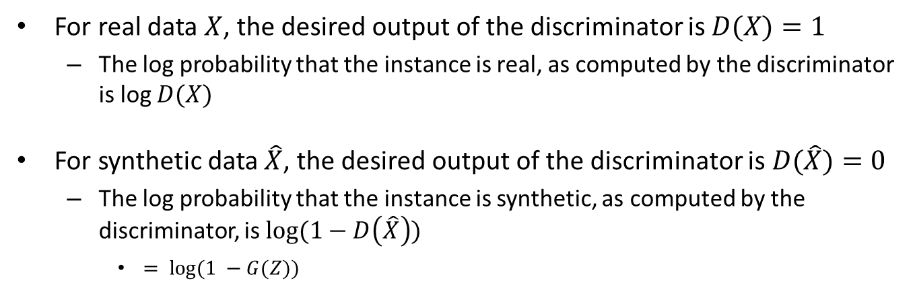
The GAN formulation
For real data $X$, the desired output of the discriminator is $D(X)=1$
The log probability that the instance is real, as computed by the discriminator is log $D(X)$
For synthetic data $\hat{X}$, the desired output of the discriminator is $D(\hat{X})=0$
The log probability that the instance is synthetic, as computed by the discriminator, is $log⁡(1−D\left(\hat{X}\right))$
$= log⁡(1 −G(Z))$

Slide 16
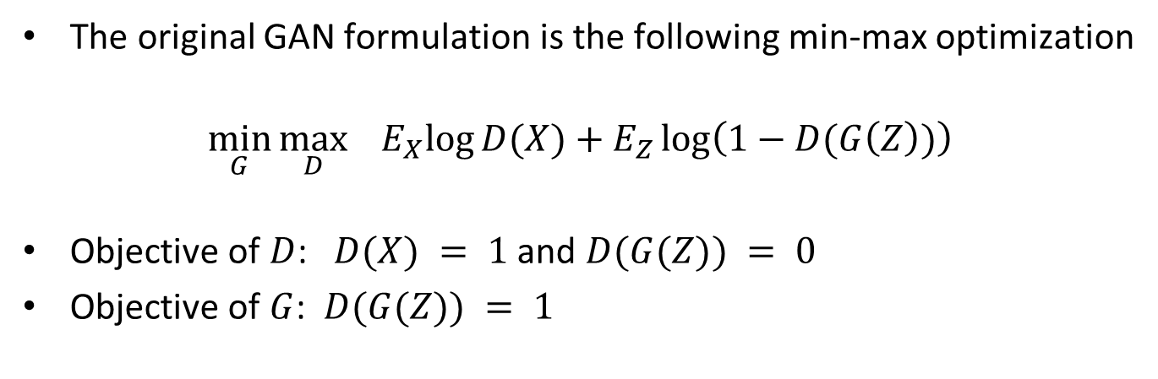
The GAN formulation
The original GAN formulation is the following min-max optimization
$$\min_{G}{\max_{D}{{ E}_{X}\log{D(X)}+E_{Z}\log\left(1−D(G\left(Z\right))\right)}}$$
Objective of $D$: $D(X) = 1$and $D(G(Z)) = 0$
Objective of $G$: $D(G(Z)) = 1$

Slide 17
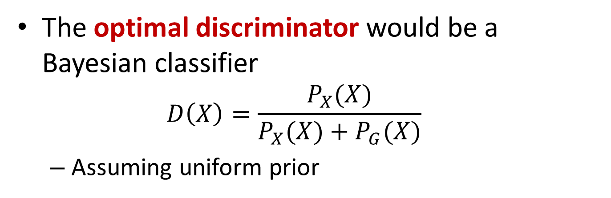
Analysis of optimal behavior: The optimal discriminator
The optimal discriminator would be a Bayesian classifier
$$D\left(X\right)=\frac{P_{X}(X)}{P_{X}(X)+P_{G}(X)}$$
Assuming uniform prior

Slide 18
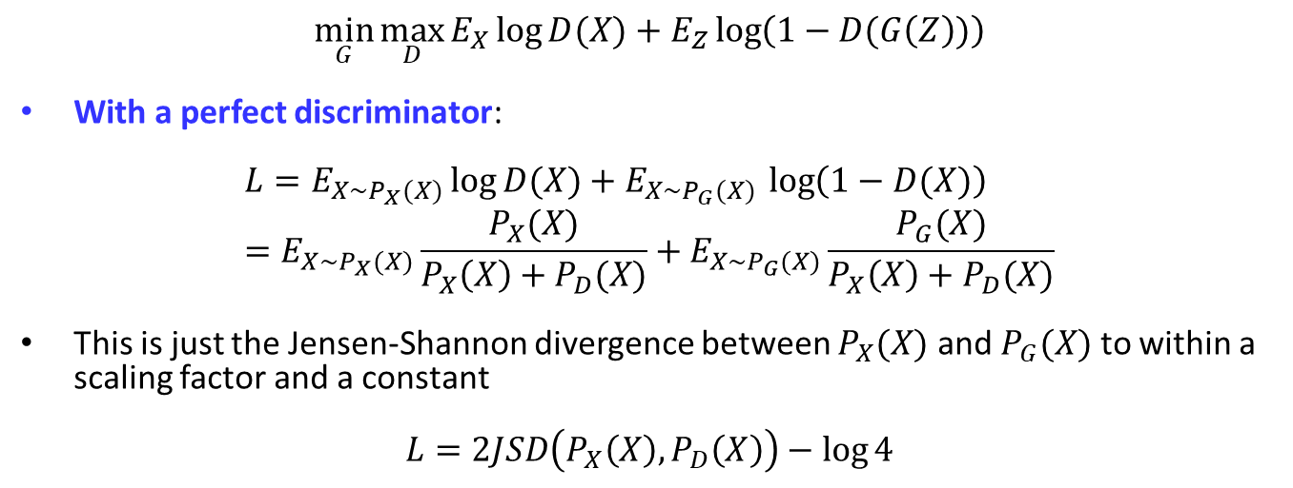

Analysis of optimal behavior: The optimal generator
$$D\left(X\right)=\frac{P_{X}(X)}{P_{X}(X)+P_{G}(X)}$$
$$\min_{G}{\max_{D}{E_{X}\log{D(X)}+E_{Z}\log\left(1−D(G\left(Z\right))\right)}}$$
With a perfect discriminator:
$$L=E_{X\sim P_{X}(X)}\log{D(X)}+E_{X\sim P_{G}(X) }\log\left(1−D(X)\right)=E_{X\sim P_{X}(X)}\frac{P_{X}(X)}{P_{X}\left(X\right)+P_{D}(X)}+E_{X\sim P_{G}(X)}\frac{P_{G}(X)}{P_{X}\left(X\right)+P_{D}(X)}$$
This is just the Jensen-Shannon divergence between $P_{X}(X)$ and $P_{G}(X)$ to within a scaling factor and a constant
$$L=2JSD\left(P_{X}\left(X\right),P_{D}\left(X\right)\right)−\log{4}$$

Slide 19
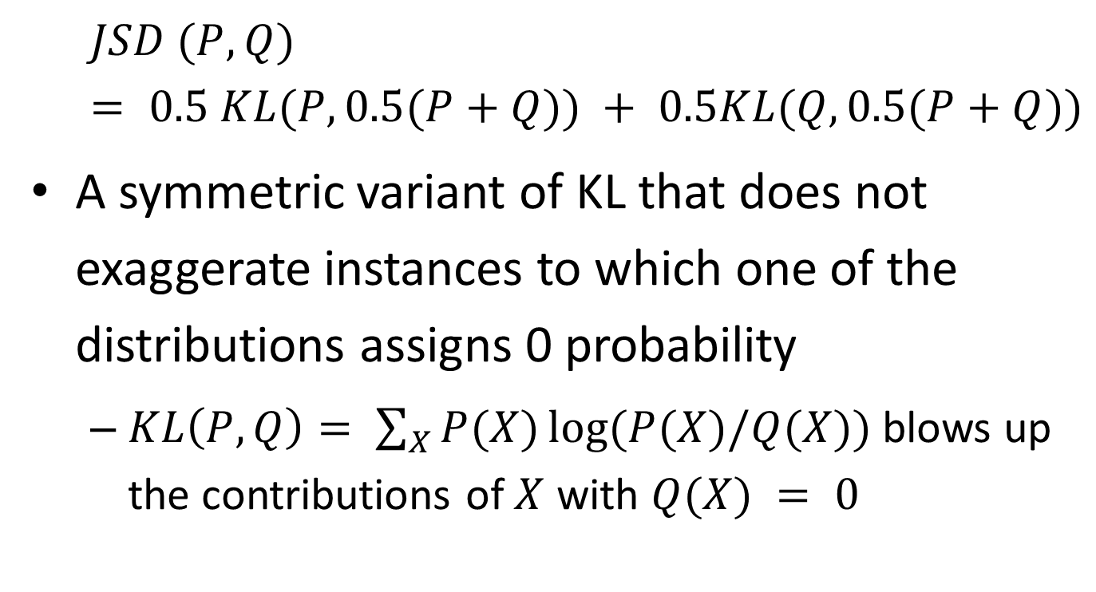
The Jensen Shannon Divergence
$$JSD (P,Q) = 0.5 KL(P, 0.5(P+Q)) + 0.5KL(Q, 0.5(P+Q))$$
A symmetric variant of KL that does not exaggerate instances to which one of the distributions assigns 0 probability
$KL\left(P,Q\right)= \sum_{X}{P(X)}log⁡(P(X)/Q(X))$ blows up the contributions of $X$ with $Q(X) = 0$

Slide 20
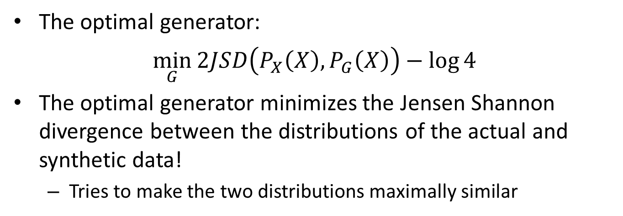
Analysis of optimal behavior: The optimal generator
$$D\left(X\right)=\frac{P_{X}(X)}{P_{X}(X)+P_{G}(X)}$$
The optimal generator:
$$\min_{G}{2JSD\left(P_{X}\left(X\right),P_{G}\left(X\right)\right)−\log{4}}$$
The optimal generator minimizes the Jensen Shannon divergence between the distributions of the actual and synthetic data!
Tries to make the two distributions maximally similar

Slide 21
Min-Max Stationary Point
There exists a stationary point:
If the generated data exactly matches the real data, the discriminator outputs 0.5 for all inputs
If discriminator outputs 0.5, the gradients for the generator is flat, so generator does not learn
Unfortunately, this is also true of a random discriminator
Stationary points need not be stable (depends on the exact GANs formulation and other factors)
Generator may overshoot some values or oscillate around the optimum
A discriminator with unlimited capacity can still assign an arbitrarily large distance to 2 similar distributions

Slide 22
Min-Max Optimization
Generator and the discriminator need to be trained simultaneously
If discriminator is undertrained, it provides sub-optimal feedback to the generator
If the discriminator is overtrained, there is no local feedback for marginal improvements

Slide 23
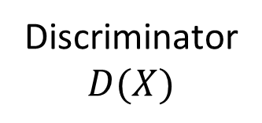


How to Train a GAN?
Discriminator $$D(X)$$
Generator $$G(Z)$$
Step 1:
Train the Discriminator using the current Generator
Step 2:
Train the Generator to beat the Discriminator
Optimize: $\min_{G}{\max_{D}{E_{X}\log{D(X)}+E_{Z}\log\left(1−D(G\left(Z\right))\right)}}$
The discriminator is not needed after convergence

Slide 24
Features and Challenges
GANs can produce clear crisp results for many problems
But they also have stability issues and are hard to train
Problems such as “mode collapse” are frequent
Producing outputs with very low variability

Slide 25
Variants and updates
A number of variations have been proposed to improve the stability and outputs of GANs
LAPGAN
Wasserstein GAN
C-GAN
DCGAN
CycleGAN
StarGAN
…

Slide 26
Evaluate with Discriminative Network
Inception Score
Use the Inception V3 image classifier to classify generated images
Inception should produce a variety of labels
As measured by the entropy of the average label distribution
Each label should have high confidence (low entropy)
As measured by the average entropy of the Inception outputs for individual instances
The two scores are combined into a single “inception” score

Slide 27
VAEs vs GANs
VAEs
GANs
Minimizing the KL divergence between distributions of synthetic and true data
Uses an encoder to predict latent distributions to optimize generator
More complex formulation
Simpler optimization. Trains faster and more reliably
Results are blurry
Minimizing the Jenson-Shannon divergence between distributions of synthetic and true data
Use a discriminator to optimize generator
Simpler formulation
Noisy and difficult optimization
Sharper results

Slide 28
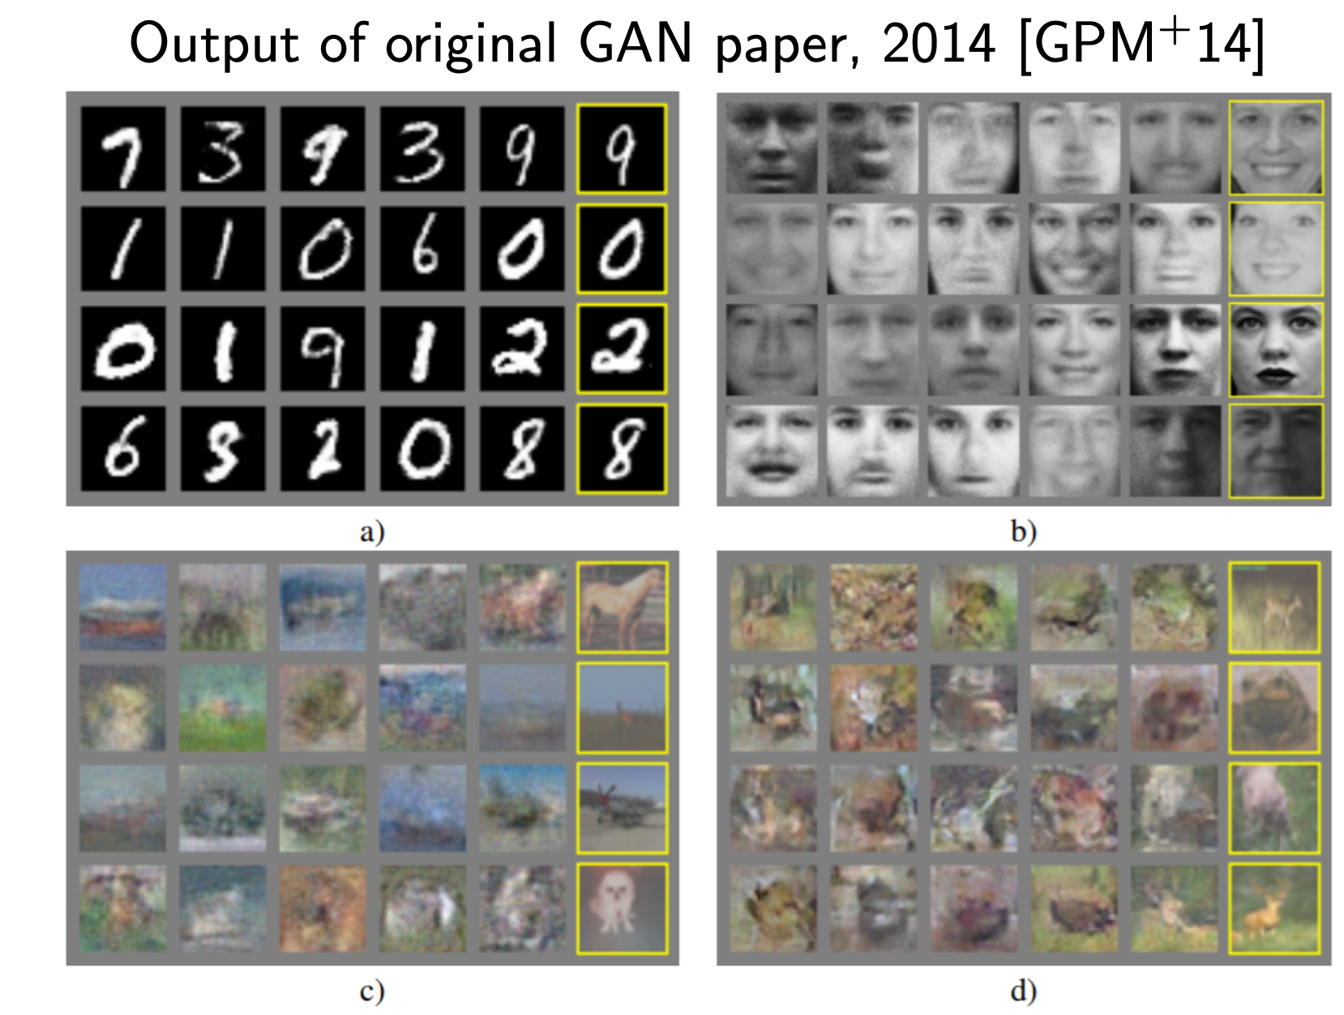
Original paper (GAN, 2014)

Slide 29
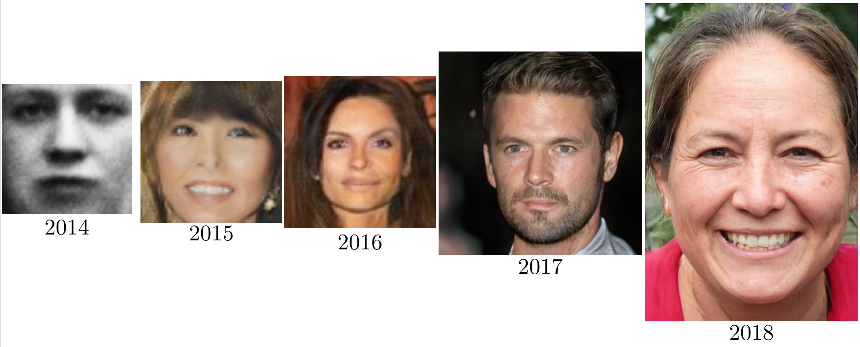
GANs with time
Better quality
High Resolution
https://twitter.com/goodfellow_ian/status/1084973596236144640?lang=en

Slide 30
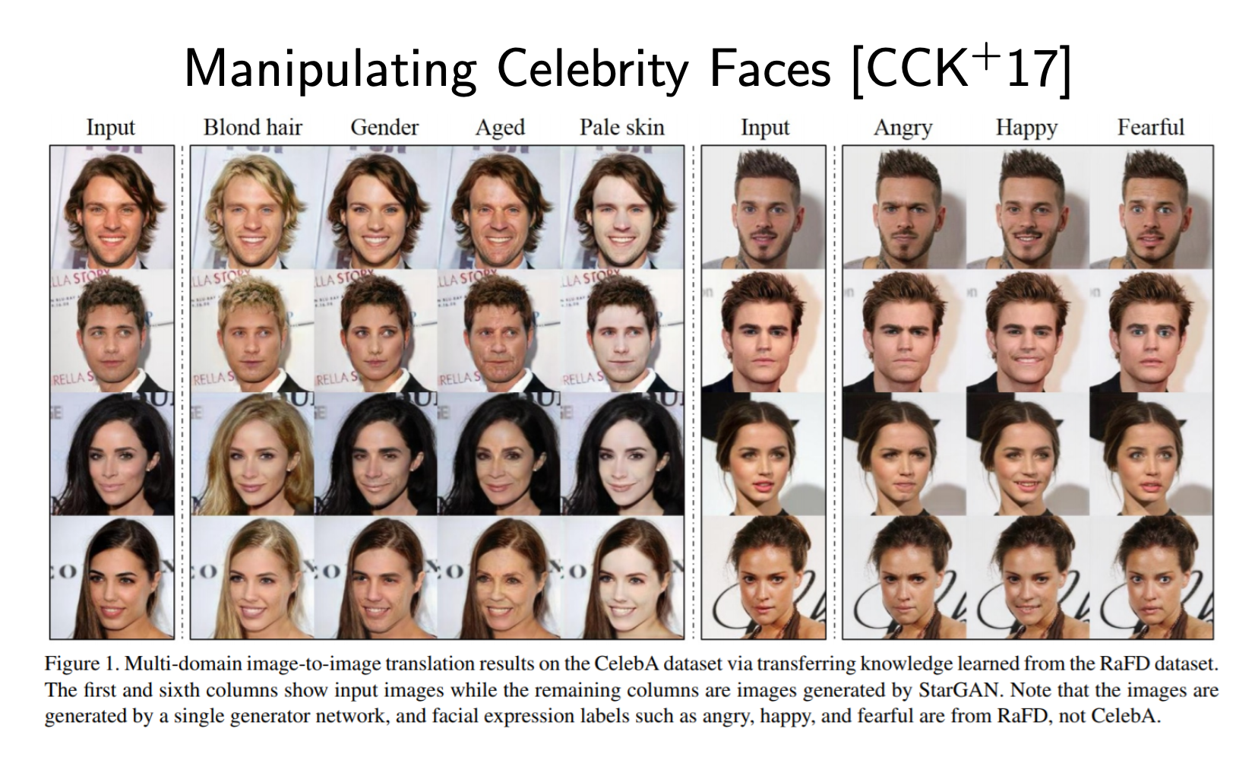
StarGAN(2018)

Slide 31
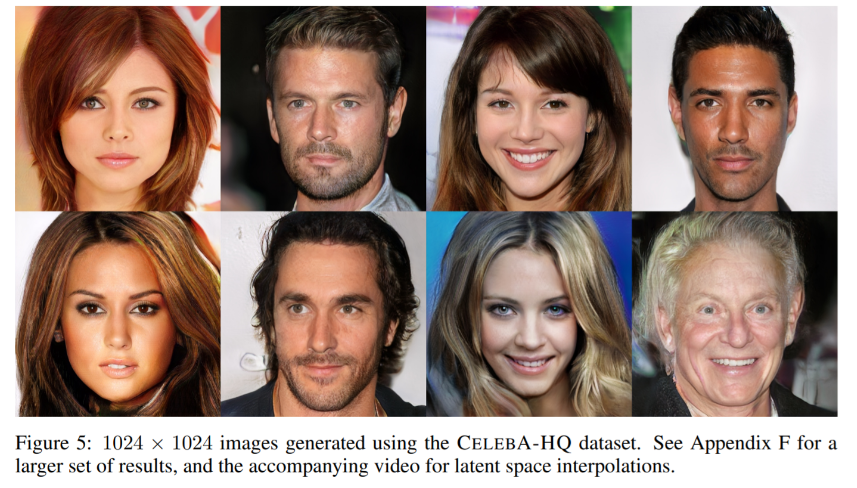
Progressive growing of GANs (2018)

Slide 32
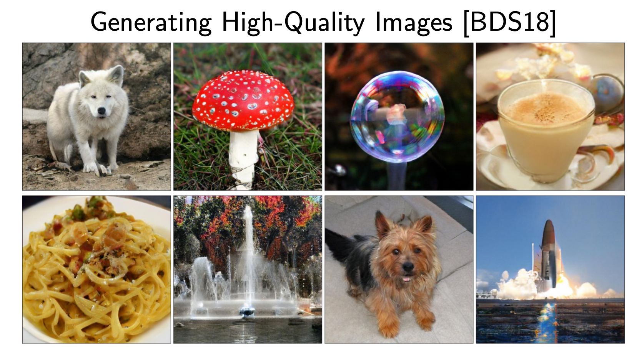
High fidelity natural images (2019)

